Slide 1

CS860: Artificial Intelligence
Lecture # 1: Intelligent Agents Instructor: Dr. Soyiba Jawed

Slide 2
Intelligent Agents
Agents and environments
Rationality
PEAS (Performance measure, Environment, Actuators, Sensors)
Environment types
Agent types

Slide 3
Agents
An agent is anything that can be viewed as perceiving its environment through sensors and acting upon that environment through actuators
Human agent: eyes, ears, and other organs for sensors; hands,
legs, mouth, and other body parts for actuators
Robotic agent: cameras and infrared range finders for sensors;
various motors for actuators

Slide 4
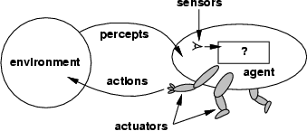
Agents and environments
The agent function maps from percept histories to actions:
[f : P* → A]
The agent program runs on the physical architecture to produce f

Slide 5

Vacuum-cleaner world
Percepts: location and contents, e.g., [A,Dirty]
Actions: Left, Right, Suck, NoOp

Slide 6
Rational agents
An agent should strive to "do the right thing", based on what it can perceive and the actions it can perform. The right action is the one that will cause the agent to be most successful
Performance measure: An objective criterion for success of an agent's behavior
E.g., performance measure of a vacuum-cleaner agent could be amount of dirt cleaned up, amount of time taken, amount of electricity consumed, amount of noise generated, etc.

Slide 7
Rational agents
Rational Agent: For each possible percept sequence, a rational agent should select an action that is expected to maximize its performance measure, given the evidence provided by the percept sequence and whatever built-in knowledge the agent has.

Slide 8
Rational agents
Rationality is distinct from omniscience (all-knowing with infinite knowledge)
Agents can perform actions in order to modify future precepts so as to obtain useful information (information gathering, exploration)
An agent is autonomous if its behaviour is determined by its own experience (with ability to learn and adapt)

Slide 9
PEAS
PEAS: Performance measure, Environment, Actuators, Sensors
Must first specify the setting for intelligent agent design
Consider, e.g., the task of designing an automated taxi driver:
Performance measure
Sensors
Environment
Actuators

Slide 10
PEAS
Agent: Medical diagnosis system
Performance measure: Healthy patient, minimize costs, lawsuits
Environment: Patient, hospital, staff
Actuators: Screen display (questions, tests, diagnoses, treatments, referrals)
Sensors: Keyboard (entry of symptoms, findings, patient's answers)

Slide 11
PEAS
Agent: Part-picking robot
Performance measure: Percentage of parts in correct bins
Environment: Conveyor belt with parts, bins
Actuators: Jointed arm and hand
Sensors: Camera, joint angle sensors

Slide 12
PEAS
Agent: Interactive English tutor
Performance measure: Maximize student's score on test
Environment: Set of students
Actuators: Screen display (exercises, suggestions, corrections)
Sensors: Keyboard

Slide 13
Environment types
Fully observable (vs. partially observable):
An agent's sensors give it access to the complete state of the environment at each point
Deterministic (vs. stochastic):
The next state of the environment is completely determined by the current state and the action executed by the agent. (If the environment is deterministic except for the actions of other agents, then the environment is strategic)
Episodic (vs. sequential):
The agent's experience is divided into atomic "episodes" (each episode consists of the agent perceiving and then performing a single action), and the choice of action in each episode depends only on the episode itself

Slide 14
Environment types
Static (vs. dynamic):
Discrete (vs. continuous):
A limited number of distinct, clearly defined precepts and actions.
An agent operating by itself in an environment.
The environment is unchanged while an agent is deliberating. (The environment is semidynamic if the environment itself does not change with the passage of time but the agent's performance score does)
Single agent (vs. multiagent):

Slide 15
Environment types
 | Chess with a clock | Chess without a clock | Taxi driving
Fully observable | Yes | Yes | No
Deterministic | Strategic | Strategic | No
Episodic | No | No | No
Static | Semi | Yes | No
Discrete | Yes | Yes | No
Single agent | No | No | No
The environment type largely determines the agent design
The real world is (of course) partially observable, stochastic, sequential, dynamic, continuous, multi-agent

Slide 16
Properties of a Chess agent
Property
Fully Observable
Description
The Chess board is fully observable to the Chess agent, nothing is hidden.
The environment changes based on actions of the Chess agent and those of the opponent. But during the period when the Chess agent is making a decision for a move, the environment (Chess board) does not change.
The Chess board changes based on the move selected by the agent, and therefore the environment is deterministic.
The Chess agent operates in episodes, alternating between agent moves and opponent moves.
The Chess board environment can be classified as single agent (if the opponent is not considered) or as multi-agent, considering that an opponent operates on the environment in a competitive fashion
Static
Determistic
Episodic
Multi-Agent

Slide 17
Properties of a non-player character agent.
Property
Partial Observability
Description
Another character in the game may not be visible to the player,
Players and NPCs compete or cooperate in the environment i n real-time,
An action taken by an agent at one time may not result in the same response when taken again (such as shooting at another player).
The FPS environment is continuous, as compared to an episodic environment such as a turn-based strategy game.
Typically, these are competitive environments, though some also include cooperative elements through support NPC agents.
Dynamic
Stochastic
Continuous
Multi-Agent

Slide 18
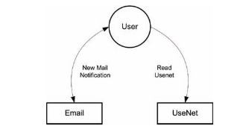
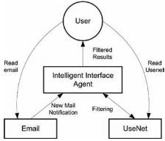
AGENT TAXONOMIES
Interface Agents
– To minimize information overload on a user, and reduce the amount of information presented to a user as a way to help the user focus on what is most important at any
given time
A user scenario for email and UseNet.
Virtual Character Agents
  A useful agent application that tak on a number of forms
es
An intelligent interface agent to minimize distractions.

Slide 19
AGENT TAXONOMIES
Entertainment Agents
used as characters in computer-generated (CG) movies or for training purposes in military simulations.
Game Agents
Non-Player Characters in games (NPCs), bring life to a variety of games by introducing characters that are autonomous and add to the realism of video games.
ChatterBots, or conversational agents
Mobile Agents
the agents have the ability to migrate from one host computer to another.
User Assistance Agent
for the purpose of simplifying our experiences when dealing with computers
Examples: Email filtering, Information Gathering and Filtering and other user assistance application
Hybrid Agents
Instead of a single characteristic, such as mobile, agents implement multiple characteristics, such as mobile and communicative.

Slide 20
Agent functions and programs
An agent is completely specified by the agent function mapping percept sequences to actions
One agent function (or a small equivalence class) is rational
Aim: find a way to implement the rational agent function concisely

Slide 21
Table-lookup agent
\input{algorithms/table-agent-algorithm}
Drawbacks:
  Huge table
  Take a long time to build the table
  No autonomy
  Even with learning, need a long time to learn the table entries

Slide 22
Agent program for a vacuum- cleaner agent
\input{algorithms/reflex-vacuum-agent- algorithm}

Slide 23
Agent properties
Property
Rationale
Description
Able to act in a rational (or intelligent) way (does the right thing at the right time, given a known outcome.)
Able to act independently, not subject to external control
Able to run continuously
Able to provide information, or command other agents
Able to work with other agents to achieve goals
Able to move (typically related to network mobility)
Able to learn and adapt
Autonomous
Persistent Communicative
Cooperative
Mobile
Adaptive

Slide 24
Agent types
Four basic types in order of increasing generality:
  Simple reflex agents
  Model-based reflex agents
  Goal-based agents
  Utility-based agents

Slide 25
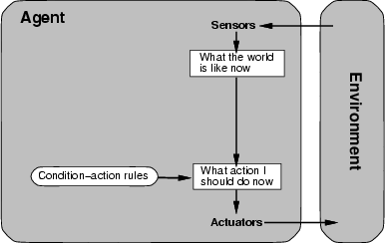
Simple reflex agents

Slide 26
Simple reflex agents
\input{algorithms/d-agent-algorithm}

Slide 27
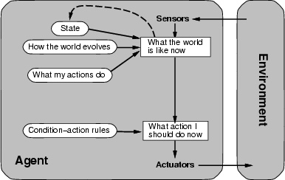
Model-based reflex agents

Slide 28
Model-based reflex agents
\input{algorithms/d+-agent-algorithm}

Slide 29
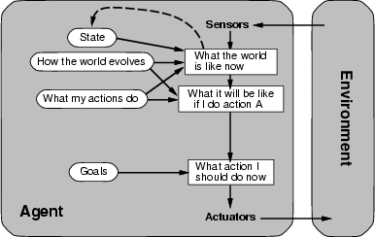
Goal-based agents

Slide 30
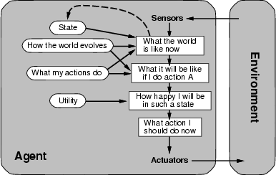
Utility-based agents

Slide 31
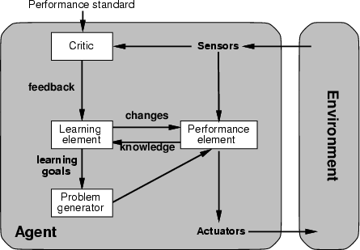
Learning agents

Slide 32
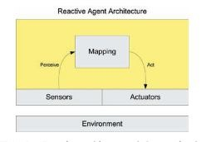
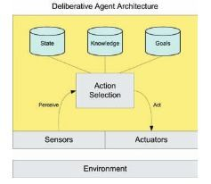
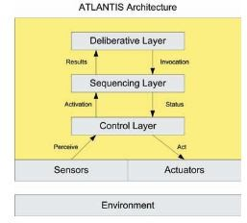
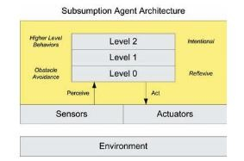
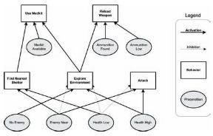
AGENT ARCHITECTURES
Reactive/ Reflex Architectures
  agent behaviors are simply a mapping between stimulus and response.
  The agent has no decision-making skills, only reactions to the environment in which it exists
  An example is Subsumption agent
  Behavior networks, created by Pattie Maes in the late 1980s, is another reactive architecture that is distributed in nature
Deliberative Architectures
one that includes some deliberation over the action to perform given the current set of inputs
Example is ATLANTIS
Behaviour network for a simple game agent

Slide 33
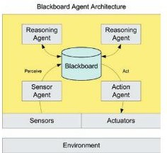
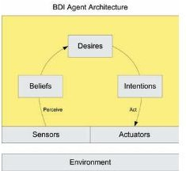
AGENT ARCHITECTURES
Blackboard Architectures
  operates around a global work area call the blackboard (a common work area for a number of agents that work cooperatively to solve a given problem
The blackboard architecture supports multi-agent problem solving.
Belief-Desire-Intention (BDI) Architecture
  follows the theory of human reasoning as
defined by Michael Bratman.
    Belief represents the view of the world by the agent (what it believes to be the state of the environment in which it exists).
    Desires are the goals that define the motivation of the agent (what it wants to achieve).
    Intentions specify that the agent uses the Beliefs and Desires in order to choose one or more actions in order to meet the desires.

Slide 34
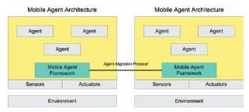
AGENT ARCHITECTURES
Hybrid Architectures
  Based on the needs of the agent system, different architectural elements can be chosen to meet those needs
Mobile Architectures
  Introduces the ability for agents to migrate themselves between hosts

Slide 35
Readings
Chapter 2, Artificial Intelligence A Modern Approach, Fourth Edition, Global Edition

